Slide 1
DATA 602 Final Project Housing Affordability Data System
Submitted by: Mohan Brahma Harsha Vanga
Presented To: Christopher McGraw

Slide 2

Introduction
Shelter is the basic need for human life where not everyone can afford it. Based on the housing affordability of the people the governments need to work on assisting them.
The main motivation for this project is to identify whether the government assisted the people in their housing or not.

Slide 3
Dataset
The dataset that I used for this project was taken from HUD User datasets: https://www.huduser.gov/portal/datasets/hads/hads.html, which consists of 64,535 rows and 100 columns.
The dataset chosen has a lot of information and I believe it has the potential to build a really good machine learning model.

Slide 4
ML Classification Algorithms
Models applied:
- Logistic Regression
- Regularization
- Decision Tree
- Random Forest
- Support Vector Classifier

Slide 5
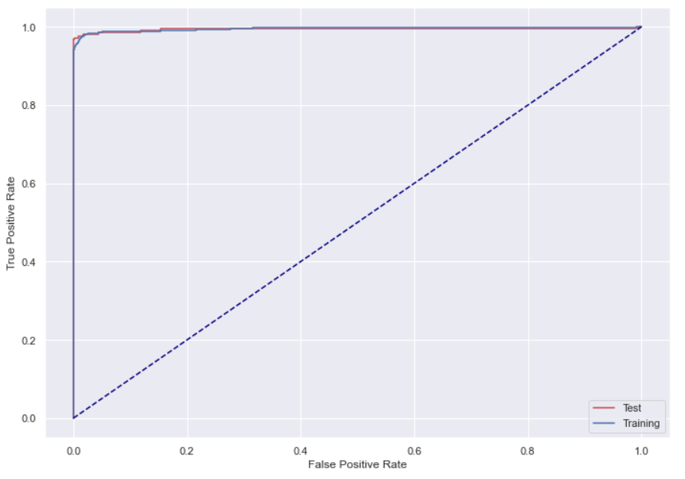
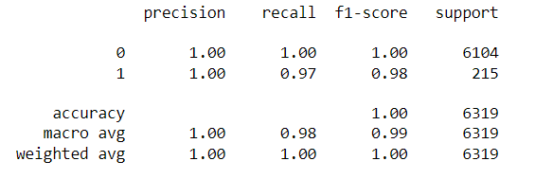
Logistic Regression
Logistic Regression gave good results with 98 and 99 percent of recall and f1-score respectively.
With less computation time, which stood out as a really good model.

Slide 6
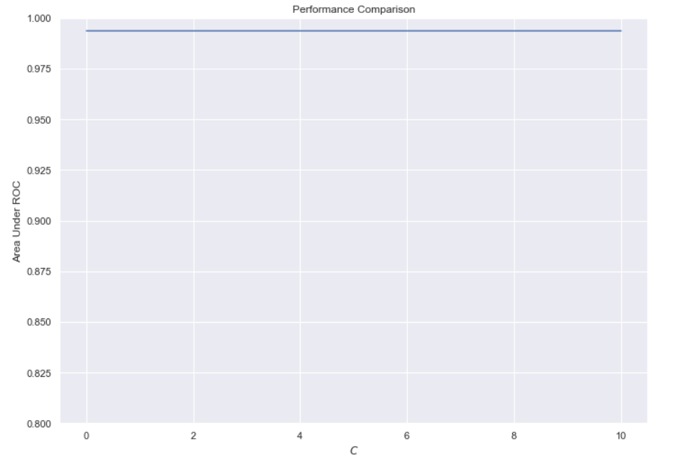
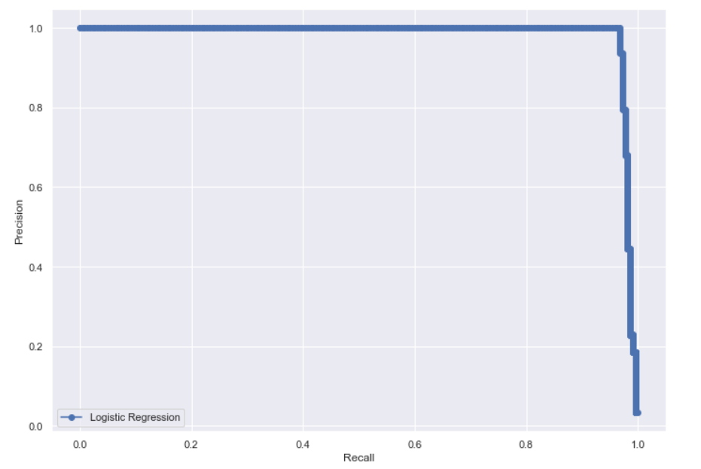
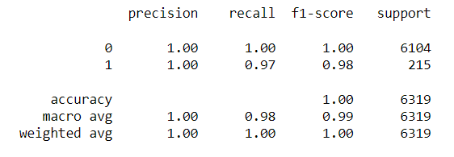
Regularization
After applying the Regularization algorithm, we could not notice any difference in the results .
So, I would say that Logistic Regression worked really well.

Slide 7
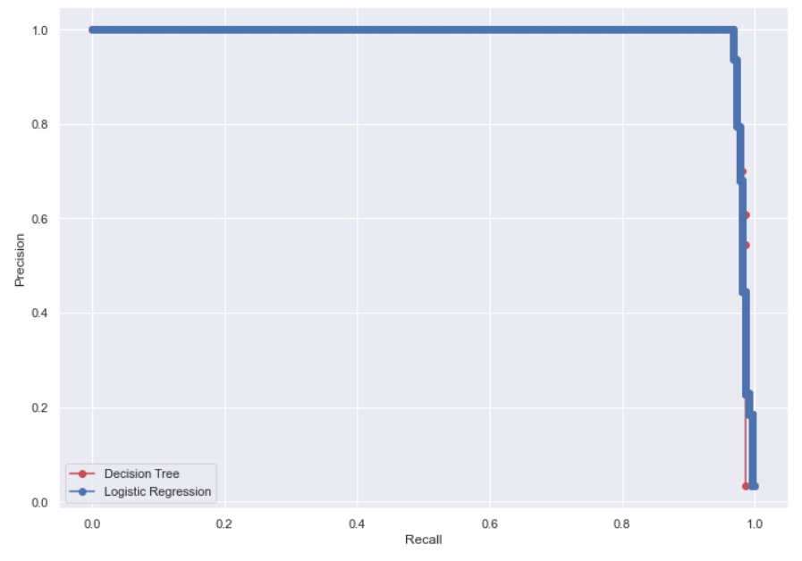
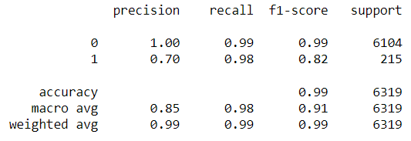
Decision Trees
I felt Decision Tree Classifier might work well on the data we have based on the way it actually works.
I expected some bettre results from this model, but we can say that precision and recall were not better than the ones that we used earlier.

Slide 8
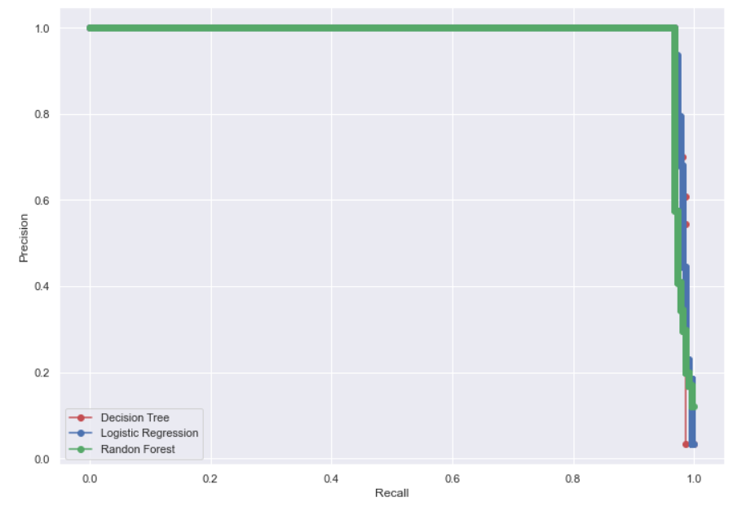
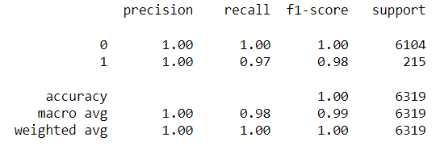
Random Forest
The performance results that we got from Random Forest model were much better that Decision Trees.
We got a macro average accuracy of 99% with the Random Forest.

Slide 9
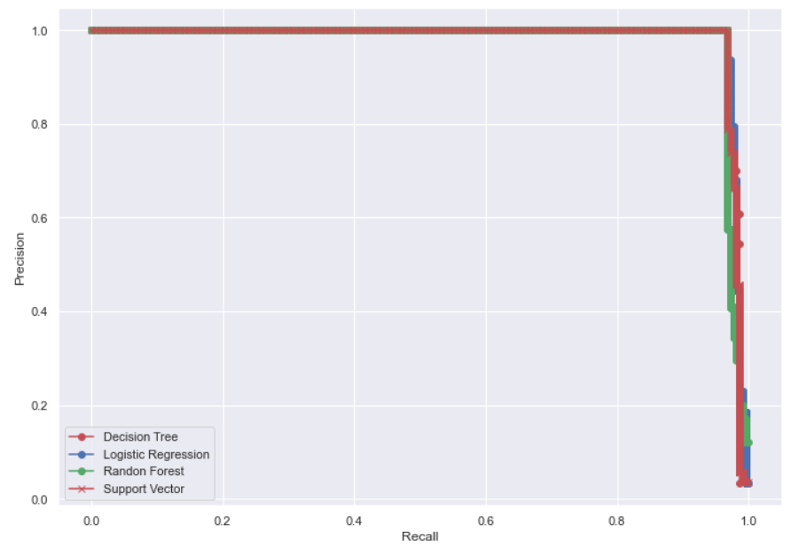
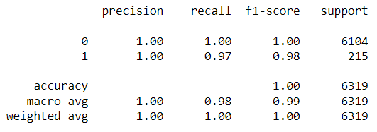
Support Vector
We got the same results with Support Vector like Logistic Regression and Random Forest which were really good.

Slide 10
Conclusion
Every model worked really well with good results except the Decision Tree.
We used Regularization to improve the results of Logistic Regression, but the results were not as expected.
There were multiple models which gave out the best results in terms of f1-scores and recall scores, particularly the Logistic Regression with regularization, support vector machine and random forest.
The highest macro avg recall we achieved was 98%.
I would go ahead with the random forest classifier.

Slide 11
Thank You

